Slide 1
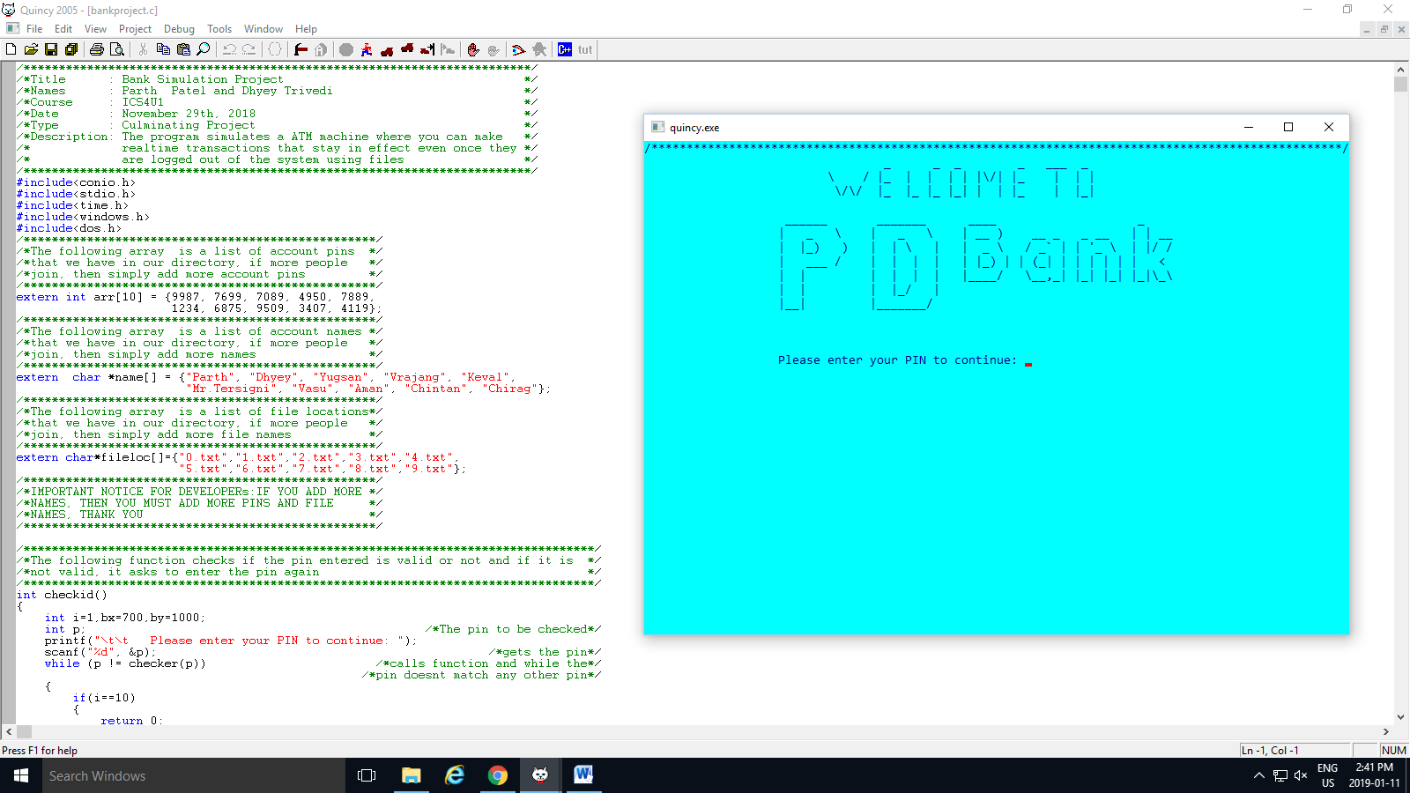
Bank ATM simulation
By, parth patel and Dhyey Trivedi

Slide 2






Assumptions

Slide 3
Purpose of idea

Slide 4



Learn real world coding

Slide 5

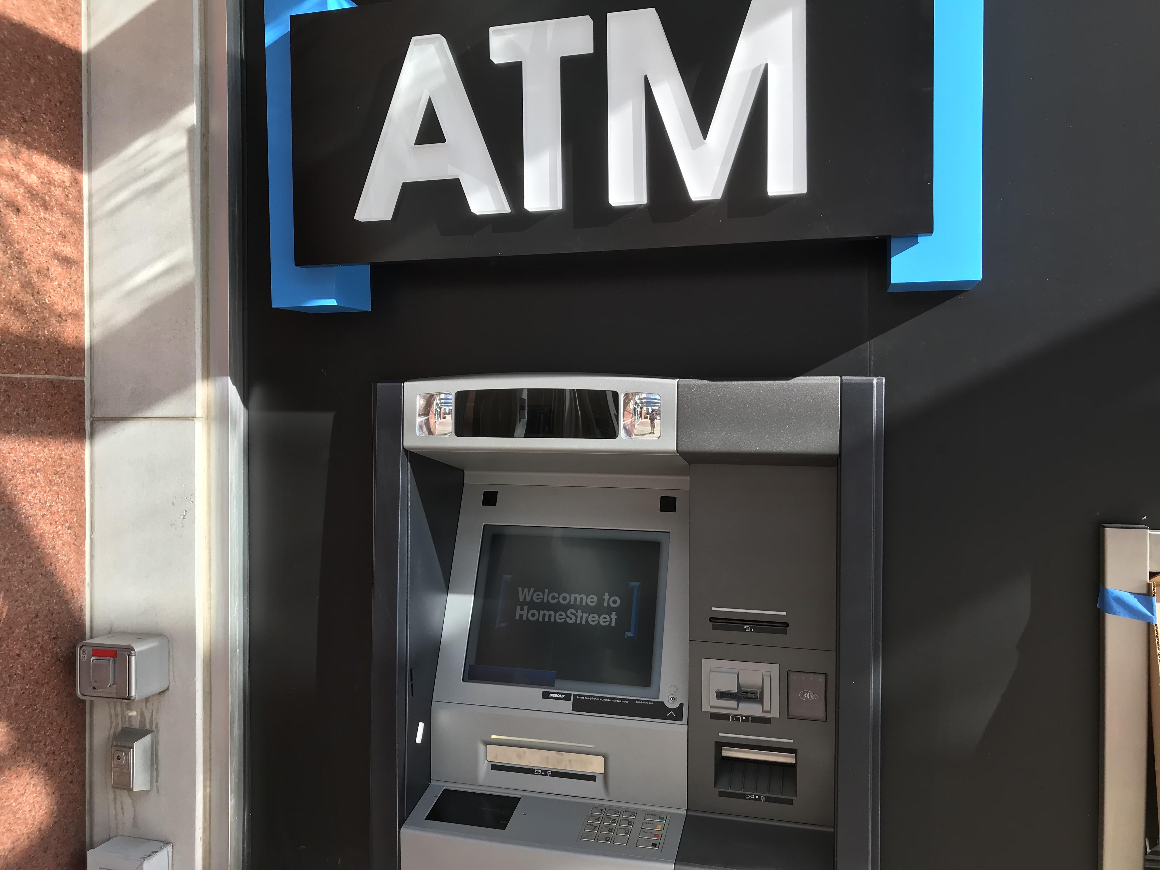

Slide 6

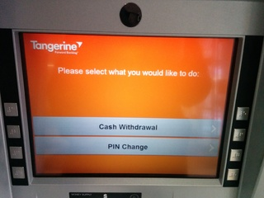


Slide 7
The Process

Slide 9

Avoiding the graphics

Slide 10

Security codes and pins

Slide 11

Then we created the main screen

Slide 12
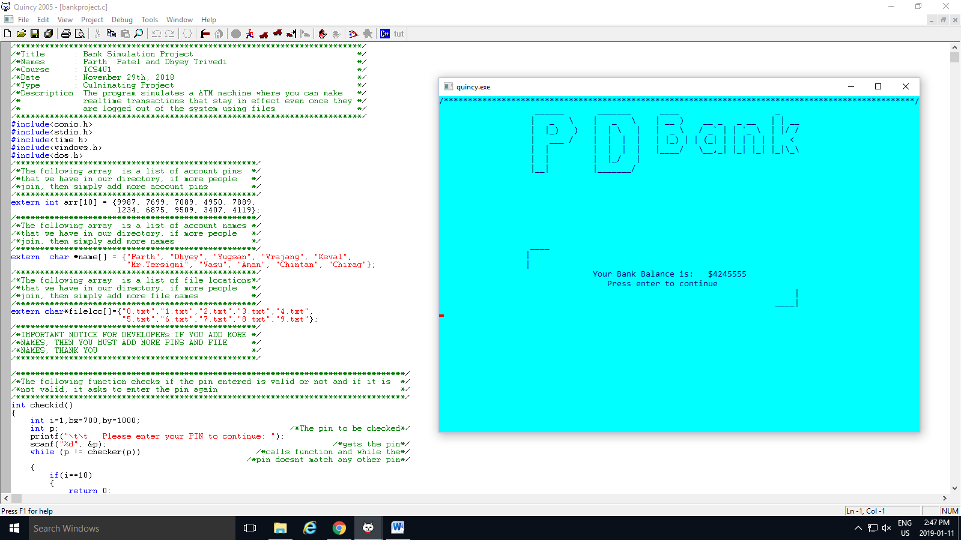
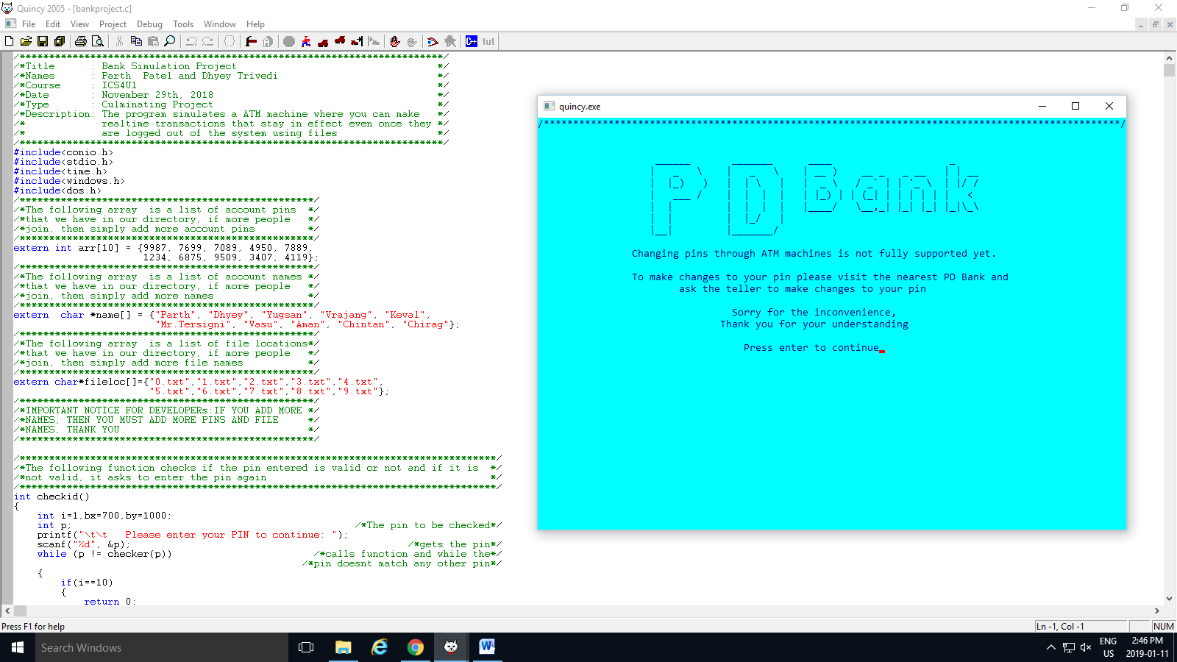



Slide 13
Algorithm

Slide 14
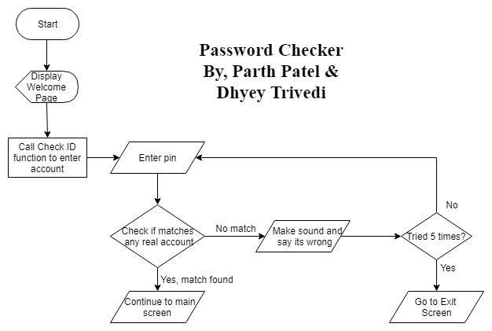
Security pin algorithm

Slide 15
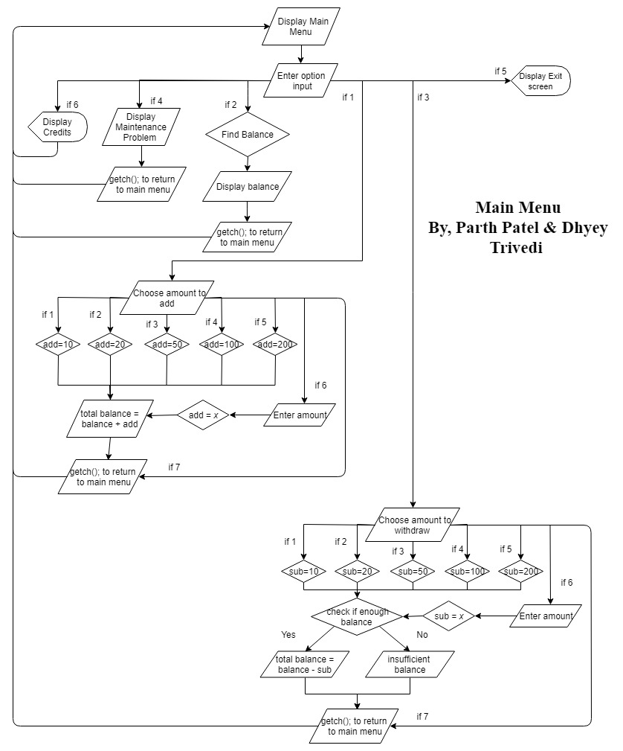
Main()
method
algorithm

Slide 16

In-Depth review of the code

Slide 17
Extra features…

Slide 18

Secure pin system!
Sound alarm!
5 tries!

Slide 19

Let’s Try!

Slide 20




Changes
Graphics

Slide 21


Thank you for watching!

